Slide 1
ROS-I Meeting 09/08/2016 Reactive and Adaptive Path Planning
GSoC 2016 student
www.kentaro.wada@gmail.com
Kentaro Wada

Slide 2
Reactive and Adaptive Path Planning
Situations that needs this planning:
Unknown environment.
Few sensors.
Many occlusions.
Inputs for reactive/adaptiveness:
Sensor input.
User operation.
For reactive and adaptive planning:
"Reactive" + "Adaptive" =
"Stop execution" + "Re-planning"
Planner
Planning
Joint Trajectory
User
Controller
User Input
Plan for goal
Stop and Re-plan
Sensor Input
Simulator
Sensors
Joint Trajectory
Robot
System of reactive path planning with simulated robot

Slide 3
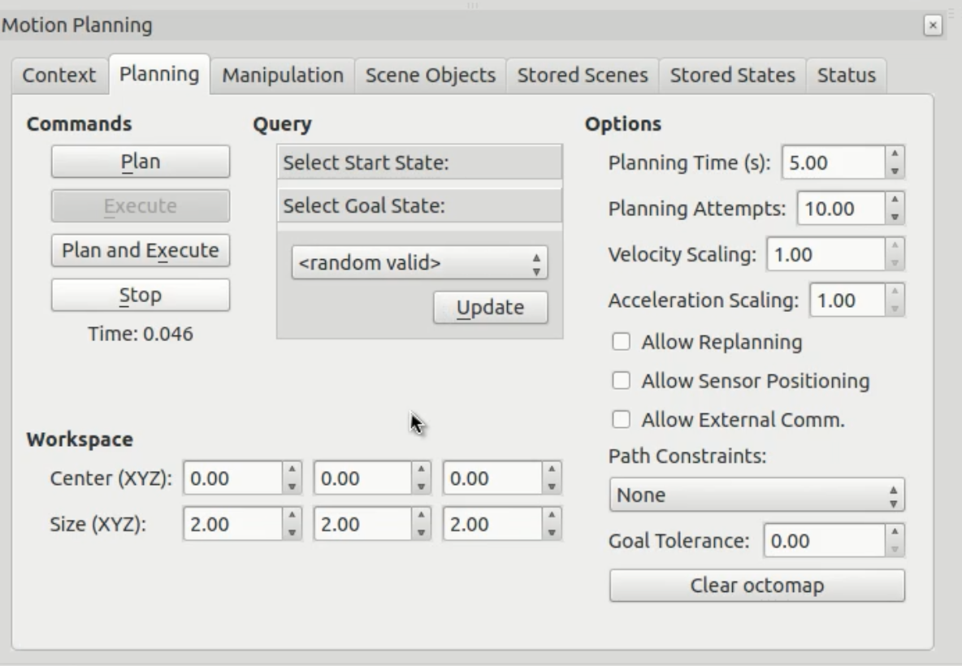
Request stops during trajectory execution
Situations about stop requests:
Request by operator for unexpected sensor input.
Request from controller for unexpected sensor input.
Required Features:
GUI for operator's stop request on Rviz. (Fig. 1)
This is completed and merged in moveit_ros.
Monitor planned joint trajectory execution.
Currently MoveIt! does not have a ROS action for execute trajectory, in spite of the necessity of monitoring for canceling.
https://github.com/ros-planning/moveit_ros/pull/719
Figure 1: GUI for operator's stop request.

Slide 4
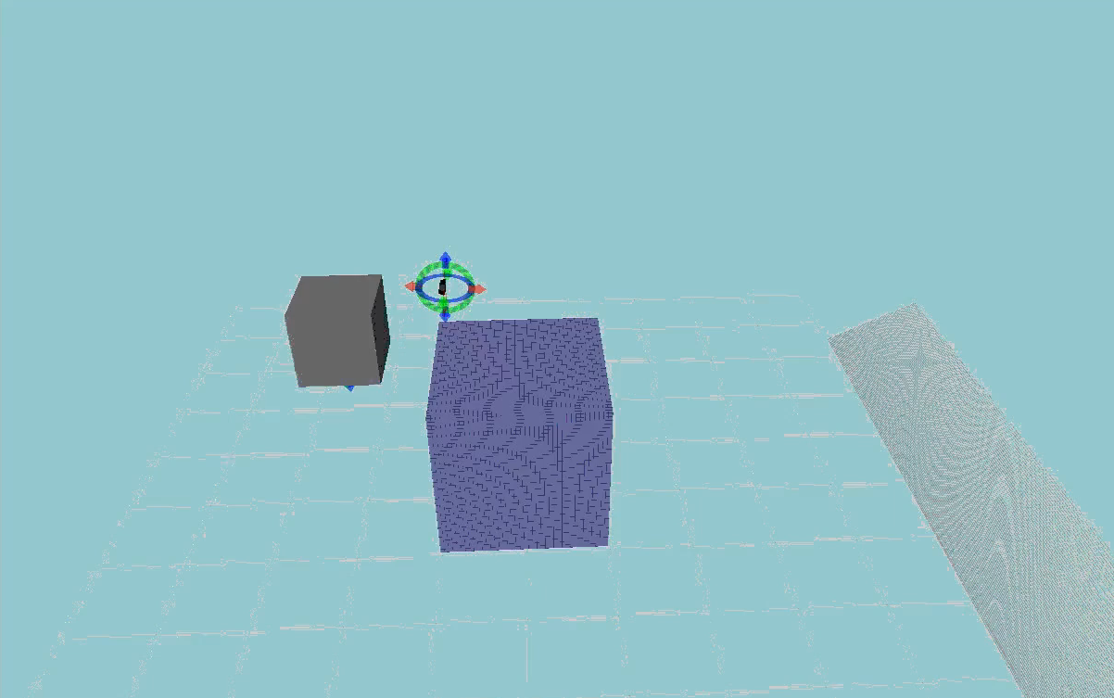
Re-planning after stopping execution
Situations about re-planning:
Re-plan by operator.
Re-plan considering about the sensor inputs before.
Required Features:
None.
Updating the planning scene or octomap.
Fix MoveIt! planning scene which is not updated after trajectory execution.
https://github.com/ros-planning/moveit_ros/issues/711
Fix octomap generation with force sensor which currently won't work. (Fig. 2)
https://github.com/jsk-ros-pkg/jsk_recognition/issues/1834
Figure 2: Octomap generation with contact.
(https://github.com/jsk-ros-pkg/jsk_recognition)

Slide 5
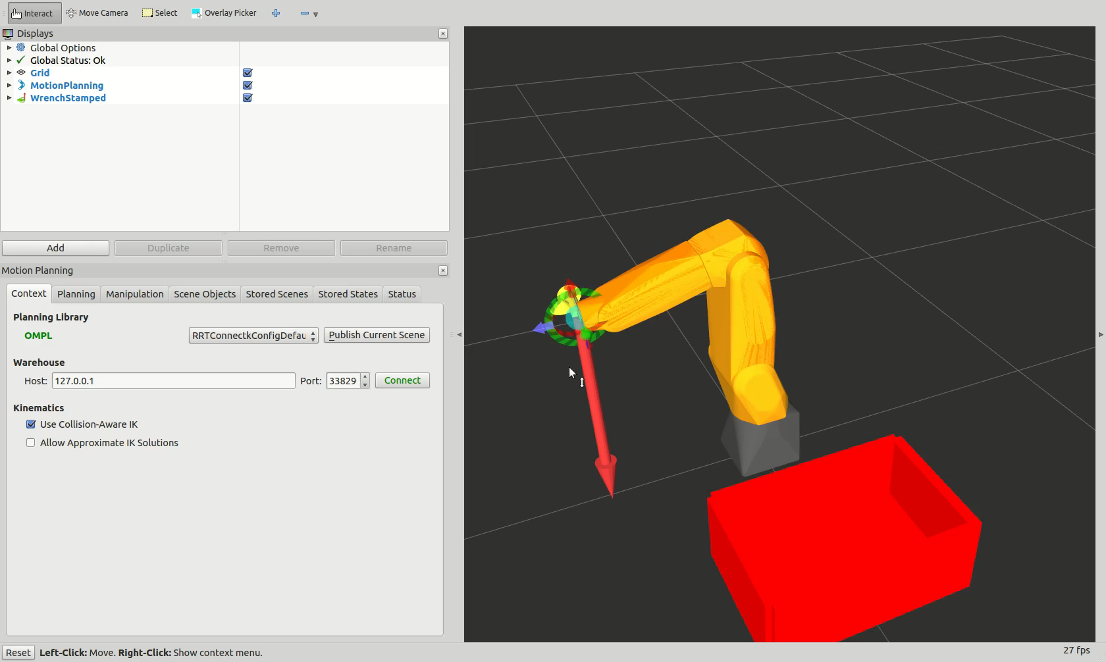
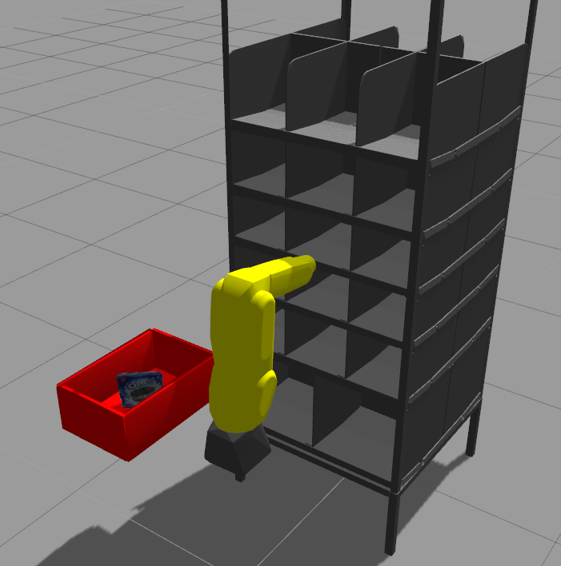
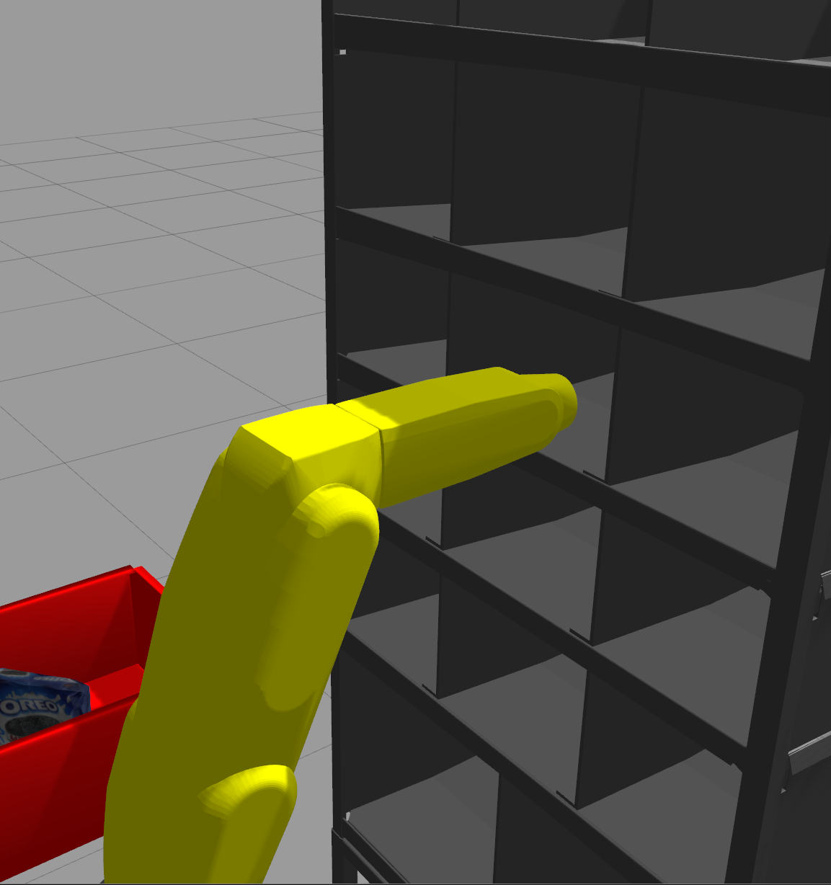
Demonstration 1: Reactive and Adaptive Path Planning with Operator Input
Pick
(not yet)
Insert
(done)
Place
(not yet)
Situation:
Robot in front of the shelf.
Shelf position can be mis-calibrated.
Visualization for operator:
Force sensor input.
MoveIt! planning, execution and stopping.
Goal:
Robot insert end-effector to the narrow space.
Initial State
Plan
Execute
Stop
Goal

Slide 6
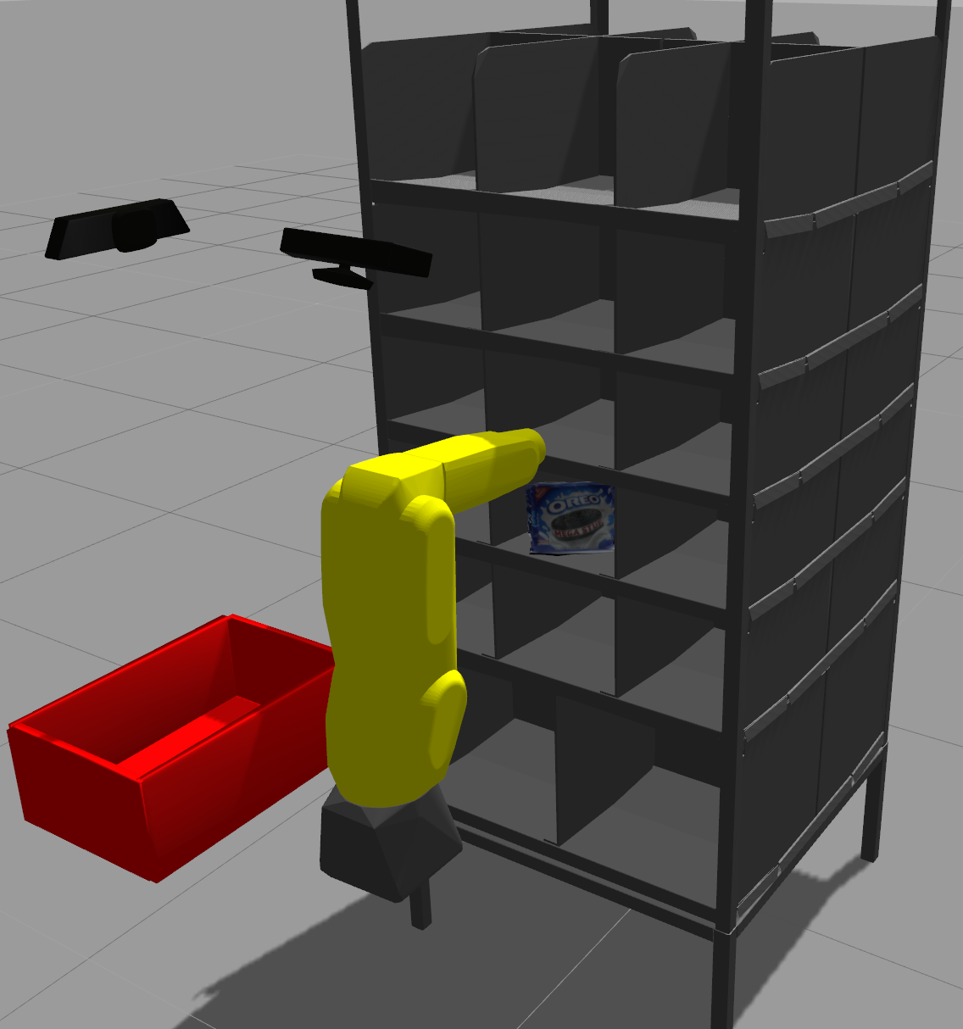
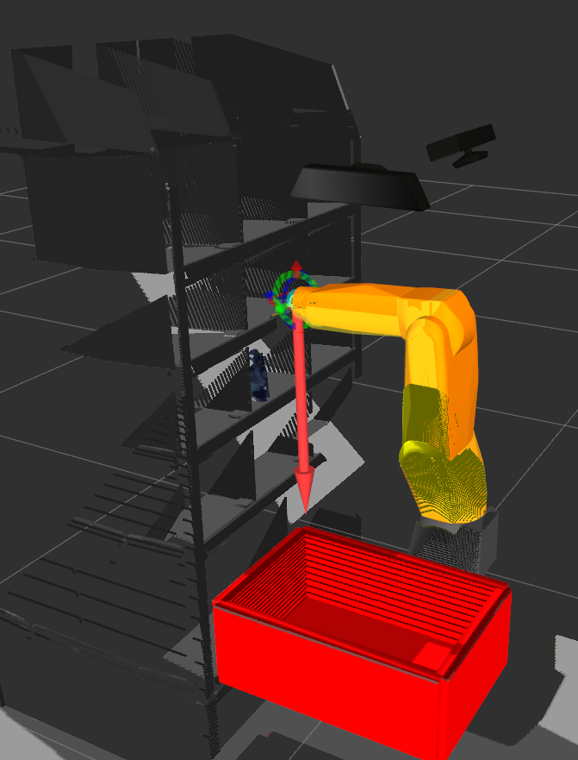
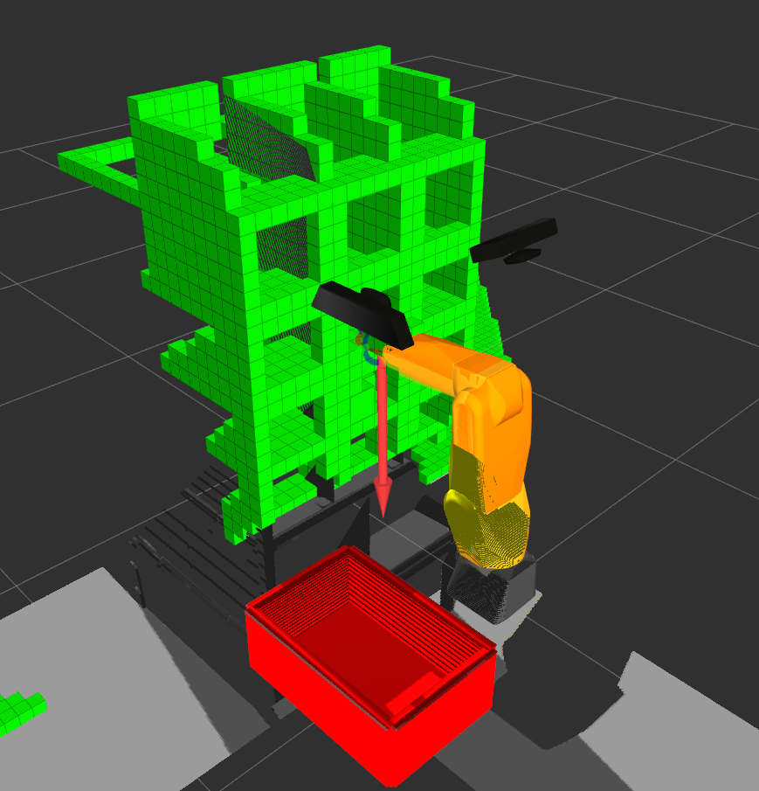
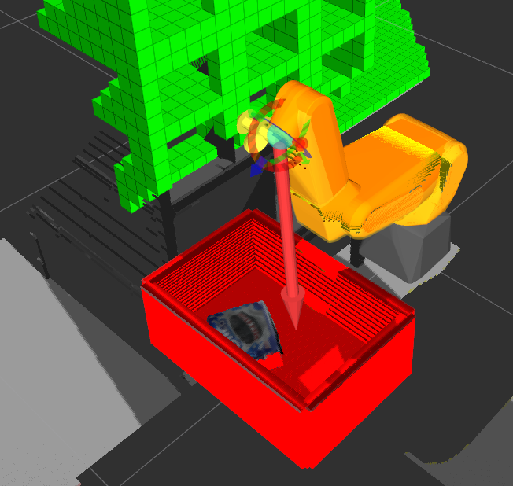
Demonstration 2: Reactive and Adaptive Path Planning with Sensor Input
Pick
(not yet)
Insert
(not yet)
Place
(not yet)
Situation:
Robot in front of the shelf.
Shelf position can be mis-calibrated.
Visualization:
Force and RGB-D sensor input.
Voxel grid mapping with octomap.
Goal:
Placing the target object in bin.
RGB-D sensors
Force sensor
Initial State
Plan
Execute
Stop
Goal

Slide 7
Next plans
Complete required features for reactive and adaptive planning for being merged to the origin.
Complete demonstration with operator input:
Complete whole system: "stow task: moving object from bin to shelf".
Complete vacuum gripper and object simulation.
Complete demonstration without operator input:
Complete whole system: "pick task: moving object from shelf to bin ".
Complete planning with scene updates with a force sensor.

